Slide 1

New API Proposal: Fraud Hotzone Alert (Communication Risk Check)
Jason Chan(Jen-Hau, Chan)
email: jhc@cht.com.tw

Slide 2
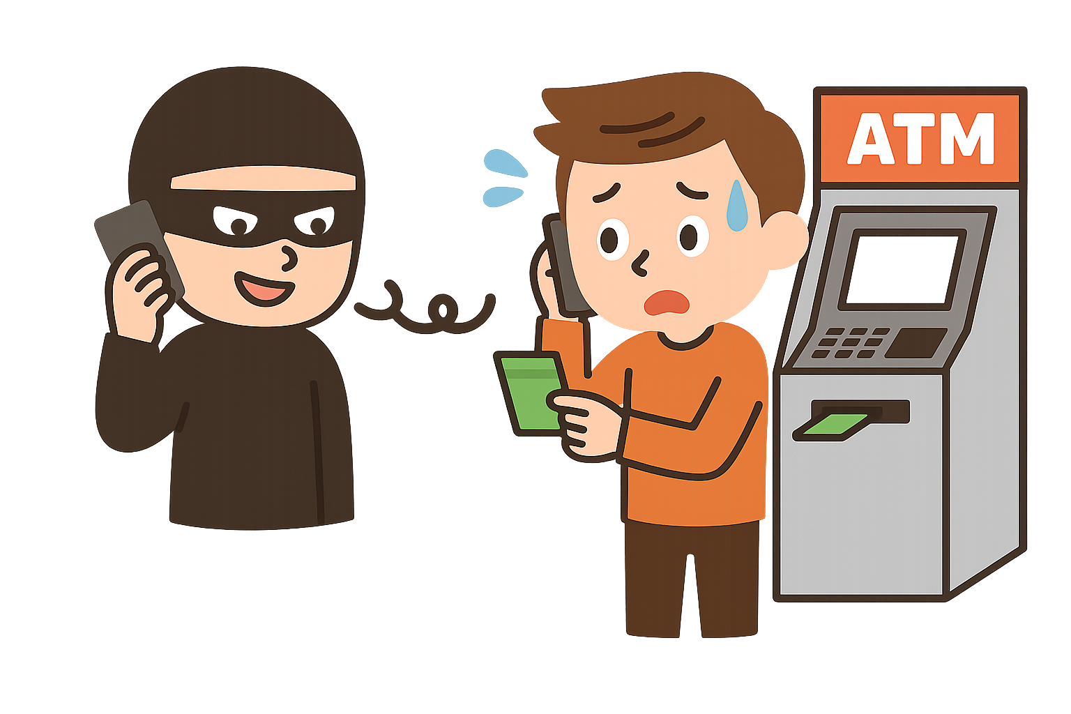



Motivation(1/2)
In current situation many scam organizations use phone calls and text messages to carry out fraudulent activities.
Challenges in Anti-Fraud Application Design:
Accurately identifying whether a target number is high risk is difficult.
Anti-fraud applications can only make educated guesses based on limited scenarios.
We propose the Fraud Hotzone Alert API, which uses anti-fraud indicators of target phone numbers to determine whether communication behavior is abnormal in specific fraud hot zones or countries.
This enables anti-fraud applications to assess the risk from two perspectives:
detecting suspects and protecting victims.
Fraud Hotzone Alert API

Slide 3
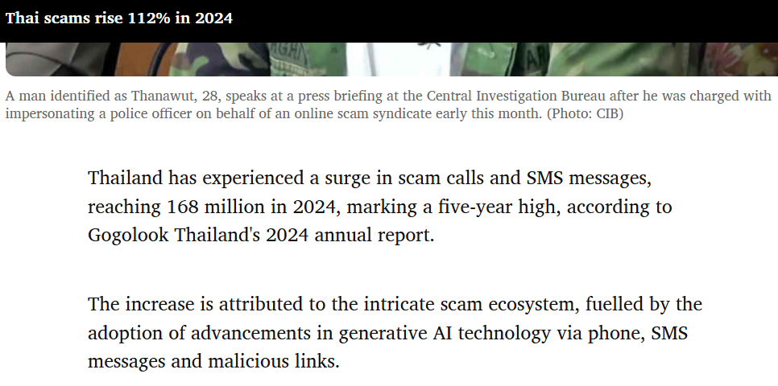
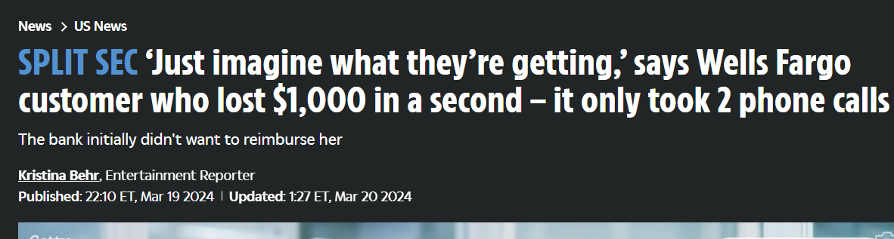
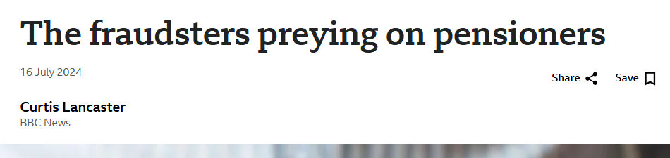
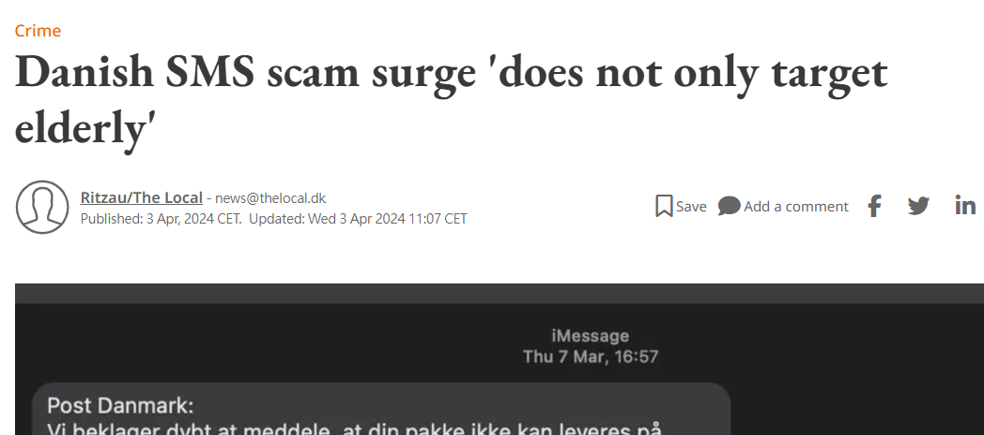
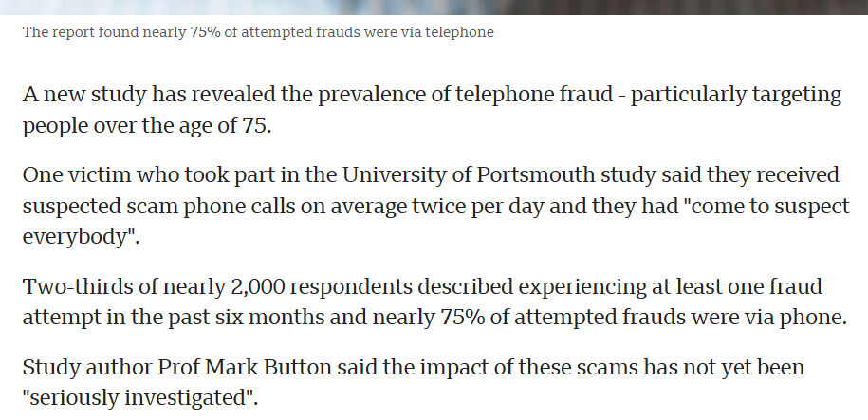
Motivation(2/2)
Tailand
America
UK
Denmark
International Attention to Phone & SMS Scam
Notes:
https://www.bangkokpost.com/business/general/2967346/thai-scams-rise-112-in-2024?utm_source=chatgpt.com

Slide 4
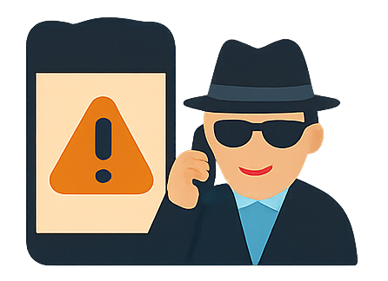
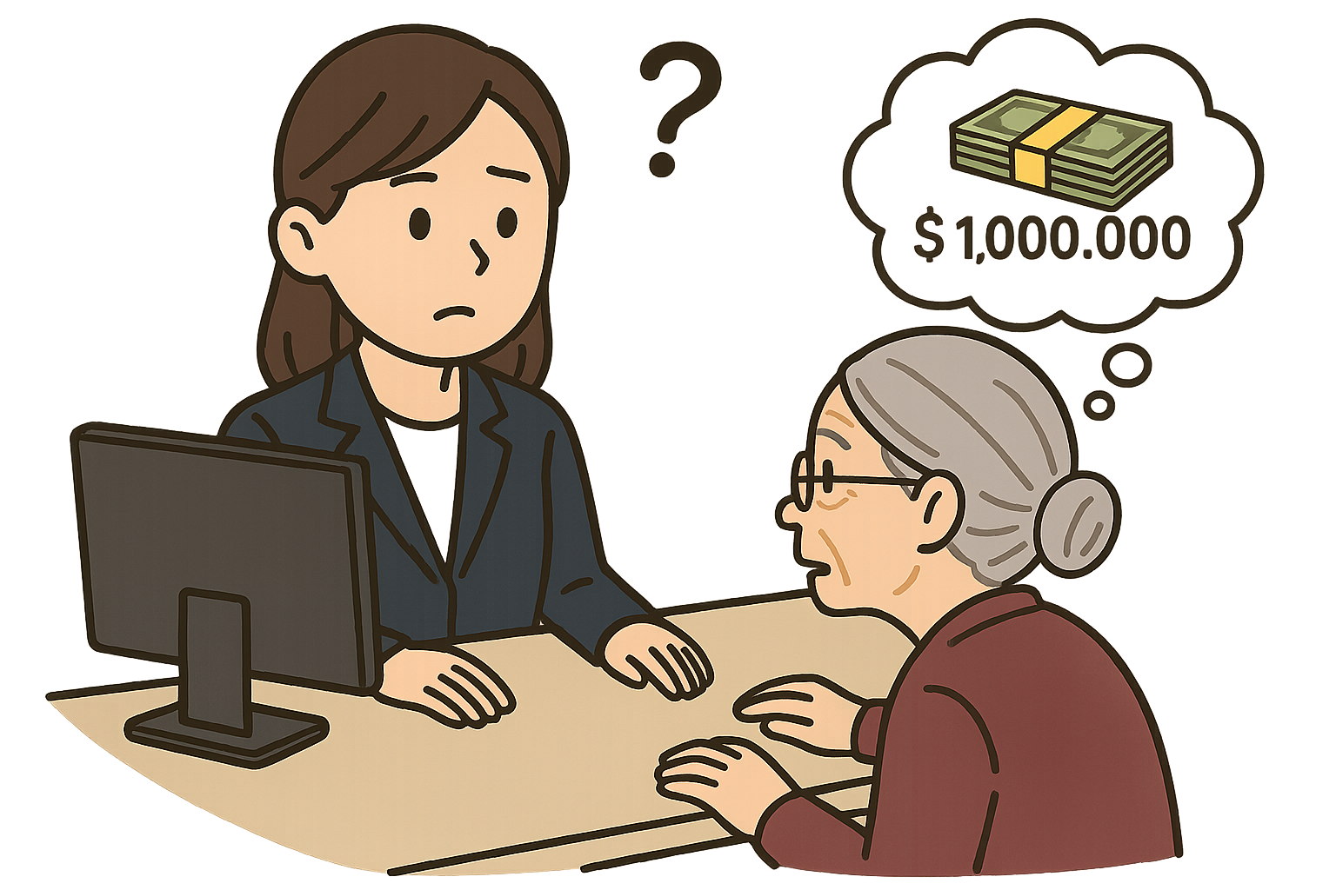
Suggested Use Case
Here are some suggested API use cases to address these issues:
Government
Financial services & insurance
ICT Services
Financial services & insurance
1.
2.
Phone Scams
Suspicious Withdrawal
Fraud Hotzone Alert API helps banks enhance real-time risk detection of incoming calls when bank customers receive suspicious scam calls during money transfers, effectively preventing fraud.
With this API, banks can detect abnormal changes in past communication behavior to determine whether the caller may be a suspect.
Fraud Hotzone Alert API helps banks detect potential fraud when customers request large withdrawals. If suspicious behavior arises, staff can query the customer's communication data.
Using this API, they can detect abnormal changes in the customer's communication behavior to assess whether they might be potential victims.
Used APIs
Fraud Hotzone Alert API
Scam Signal API
Used APIs
Fraud Hotzone Alert API
Device Roaming Status API
KYC-Tenure API

Slide 5
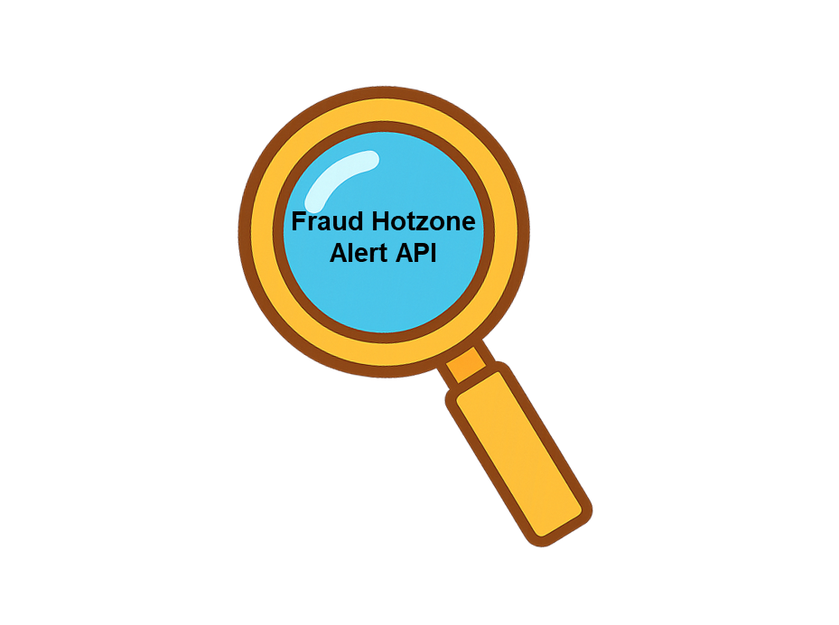

Fraud Hotzone Alert API Definition (1/5)
/surge-detection Endpoint Definition
Endpoint | Description | Request | Response
/surge-detection | Present the anomaly detected result based on the anti-fraud factors of voice or SMS activity patterns associated with phone number of a suspect or a victim within a specific time period to verify if it is classified as high-risk. | { "phoneNumber": "+886912345678", "lookBackDays": "5", "thresholdRatio“: "2.0", "method": "iterative_trim_mean", "fraudHotzone“ : "Cambodia" "checkType": "call", "checkTarget": "suspect" } | { "anomalyDetected": true, "anomalyDate": "2025-07-12" }
checkTarget: “suspect”
Fraud Hotzone Alert API

Slide 6

Fraud Hotzone Alert API Definition (2/5)
/surge-detection Endpoint Definition
Endpoint | Description | Request | Response
/surge-detection | Present the anomaly detected result based on the anti-fraud factors of voice or SMS activity patterns associated with phone number of a suspect or a victim within a specific time period to verify if it is classified as high-risk. | { "phoneNumber": "+886912345679", "lookBackDays": “14", "thresholdRatio“: “adaptive_ai", "method": "adaptive_ai", "fraudHotzone“ : "Cambodia“, “checkType”: “sms”, “checkTarget”: “victim” } | { "anomalyDetected": true, "anomalyDate": "2025-07-12" }
checkTarget: “victim”
Fraud Hotzone Alert API

Slide 7
Fraud Hotzone Alert API Definition(3/5)
Request (input)
Parameters | Definition | Format | Required
phoneNumber | The target phone number to be checked | String(follow E.164 standard) "+886912345678" | Y
lookBackDays | Number of days to look back from today | int | Y
thresholdRatio | Threshold multiplier for anomaly detection (If this field is not provided, the default value will be "adaptive_ai") | String a parsable double value like "1.5" "adaptive_ai": AI model dynamically determines the threshold based on data conditions. | N
method | Anomaly detection algorithm method (If this field is not provided, the default value will be "adaptive_ai") | String "adaptive_ai" ,"mean", "iqr", "modified_z_score", "iterative_trim_mean" or "moving_avg_threshold" | N
fraudHotzone | Identifier or name of the fraud hotzone, used to specify a high-risk scam area where the system monitors related call and SMS anomalies. (If this field is not provided, the system will default to using the government-provided fraud risk list for reference.) | String "Cambodia" | N
checkType | Specifics the type of anti-fraud factors to query | String "call":Indicate that the query is for voice call-related fraud detection factors. "sms":Indicate that the query is for SMS-related fraud detection factors. "all":Indicate that the query is for both voice call-related and SMS-related fraud detection factors. | Y
checkTarget | The perspective from which the target is being evaluated. This determines the type of analysis performed and the format of the response data | String "suspect": Indicates the target is a fraud suspect. "victim": Indicates the target is a potential victim. | Y
Notes:
Z-score、Modified Z-score (MAD)、IQR、Grubbs‘ test、Iterative trimming

Slide 8
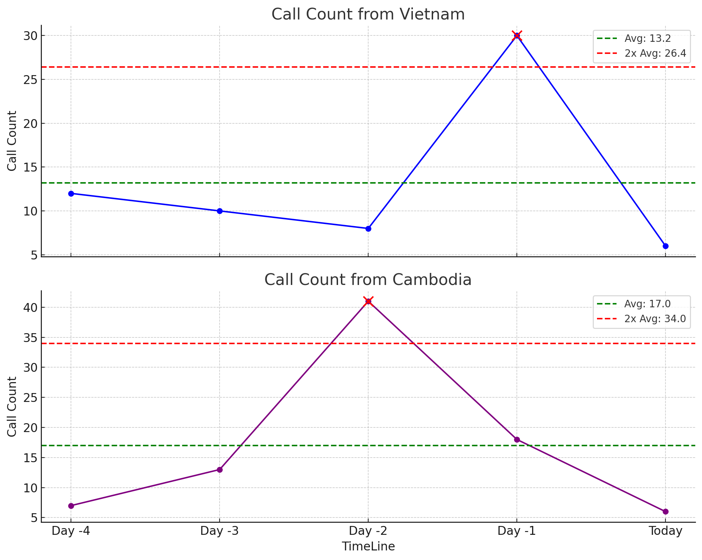
Fraud Hotzone Alert API Definition (4/5)
Response (output)
Parameters | Definition | Format | Required
anomalyDetected | Whether anomaly detected | Boolean true: anomaly behavior has been detected by the system false: no anomaly detected | Y
anomalyDate | Date when anomaly occurred | String(follow ISO 8601 date standard) : "YYYY-MM-DD" When anomalyDetected is false, this field can be null or an empty string | Y
Anomaly
Example
Request:
{
"phoneNumber": "+886912345679",
"lookBackDays": “14",
"thresholdRatio“: “adaptive_ai",
"method": "adaptive_ai",
"fraudHotzone“ : ["Cambodia“,”Vietnam”],
“checkType”: “sms”,
“checkTarget”: “victim”
}
Response:
{
"anomalyDetected": true,
"anomalyDate": ["2025-07-12“, "2025-07-13“]
}
Anomaly

Slide 9
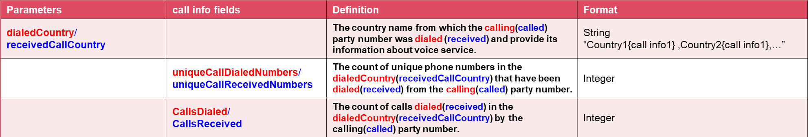
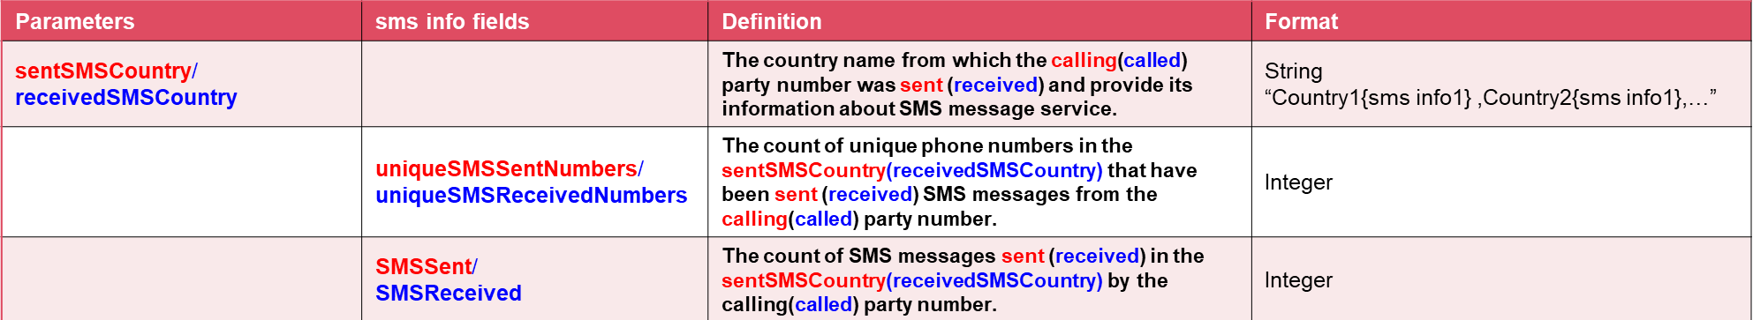
Fraud Hotzone Alert API Definition (5/5)
Algorithm Reference Data
*Red: checkTarget: “suspect”
*Blue: checkTarget: “victim”

Slide 10

Feedback & Updates (1/3)
Contributor
albertoramosmonagas commented 2 weeks ago
I am using the comments of the proposal to post the questions that came up in the WG Backlog session of 2025-07-10. Consent & Privacy How is end-user consent obtained? Is consent explicitly included in the mobile service contract? Is that consent valid for sharing sensitive data like call/SMS volume and origin information? How is GDPR (or other local privacy regulations) compliance ensured? Can users opt out or revoke consent? How is third-party data handled (e.g., the recipients of calls or SMS)? What privacy safeguards are applied to the data being shared? Is the information anonymized or aggregated? What measures are in place to prevent re-identification?
Our company's API platform requires end-users to fill out a consent form, which is then sent to us.
We recently consulted our company’s legal department regarding the user privacy consent clause included in the service agreement, but have not yet received a clear response.
However, we have already revised the API response logic to return only an anomaly status (true/false) and the date of the anomaly, which should avoid any privacy concerns.

Slide 11
API Comparison
 | Scam signal | Customer Insights | Fraud Hotzone Alert
Request | { "phoneNumber": "+123456789" } | { "phoneNumber": "+556253423432", "scoringType": "gaugeMetric" } | { "phoneNumber": "+886912345679", "lookBackDays": “14", "thresholdRatio“: “adaptive_ai", "method": "adaptive_ai", "fraudHotzone“ : ["Cambodia“,”Vietnam”], “checkType”: “sms”, “checkTarget”: “victim” }
Response | { "callInProgress": true, "callDirection": "OUTBOUND", "callDuration": "PT2M", "callStartTime": "2024-01-02T13:05:22Z" } | { "scoringType": "gaugeMetric", "scoringValue": 600 } | { "anomalyDetected": true, "anomalyDate": ["2025-07-12“, "2025-07-13“] }
Functionality and Main Goal | Determine whether the target phone number is currently on a voice call, as well as the call direction, start time, and total duration. | Input a phone number and calculate a risk score based on the user's communication and credit-related information associated with that number. | Detect abnormal communication behavior (calls or SMS) over a specific period for the target phone number of a suspect or potential victim using different algorithms, and provide the anomaly status and timestamp.

Slide 12
Feedback & Updates (2/3)
Contributor
albertoramosmonagas commented 2 weeks ago
Scope and API Design 4. How does this API differ from similar initiatives like Scam Signal or Customer Insights? Is there any overlap or redundancy? What is the unique value proposition? Is it possible to return a simplified output (e.g., a risk score: high/medium/low) instead of detailed data? Would this approach be more aligned with privacy expectations in regulated markets? Could the API offer a “lightweight” mode, only returning key indicators instead of detailed breakdowns? Adoption & Market Fit 7. Has the API been validated outside of the local market (e.g., Europe, Africa)? Are there legal or regulatory barriers in those regions? 8. Have banks or potential API consumers provided feedback confirming their need for this solution? Is there any documented interest or demand? I put in copy of the thread to those who were in the discussion @eric-murray, @tanjadegroot
We have confirmed that, in terms of functionality and core purpose, there is no overlap with Scam Signal or Customer Insights.
I’ll go through these questions using the API Comparison table to keep the replies consistent.
This API is not yet commercialized or validated.
In Taiwan, we’ve discussed the requirements with several banks, such as TBB (Taiwan Business Bank), Next Bank, and others.
We can provide these banks’ feedback as supporting evidence.

Slide 13

Feedback & Updates (3/3)
Collaborator
eric-murray commented 2 weeks ago
My concern would be relying on contract as the lawful basis for sharing this level of information is that pointing to some vague clause in the contract about "using data for fraud prevention purposes" and then saying to the customer "well, you agreed to it" is not a good look. Whilst I agree that if the end customer has "consented" to sharing this data (and for GDPR and similar, that is a high hurdle), then it's fine to share, my concern is that APIs such as this will make CAMARA look like a "privacy intrusive" organisation. CAMARA APIs are intended for "general consumption" for any API consumer who can get the informed consent of the telco customers. If it is considered that this API is only applicable to a very narrow subset of API consumers (e.g. banks) and would never be offered for general consumption, then the GSMA route might be better. I would certainly welcome the GSMA's opinion on this proposal.
Thank you for raising these important concerns. We fully agree that relying on vague contract terms is not sufficient, and transparency is essential—especially under GDPR and similar frameworks.
To address this, we’ve already revised the API to return only an anomaly status (true/false) and the date of the anomaly, without exposing any personal communication details. This significantly reduces privacy risks.

Slide 14
Fraud Prevention Requirements from NCB (original)
NCB |  |  |  |  |  | 中華數金處 |  |  | 中華研究院
項目 | 資料類別​ | 電信業提供資料​ | 建議作法​ | 詐騙態樣說明​ | 應用情境​ | 提問訊息 | 回傳值 | 是否符合法規 | GSMA API | 客製(備註說明)
01 | 用戶資料​ | 門號為預付卡或月租型​ | 1.由銀行發送門號，請中華電信回饋為預付卡或月租型門號​ | 詐騙集團使用預付卡為異常態樣之一​ | 客戶首次開戶往來或首次交易​ | 1.發送門號&預付卡[Prepaid] 2.發送門號&月租型[Postpaid ] | Y/N |  | KYC-Tenure
02 |  |  | 2.由銀行發送門號，請中華電信回饋該門號持有人姓名​ |  |  | 發送門號&姓名 | Y/N |  | TWCA MID服務
03 | 用戶行為​ | 單一客戶門號更換紀錄​ | 1.由銀行發送門號及銀行客戶姓名，請中華電信回饋是否為本人​ | 發現用戶為人頭帳戶或可疑帳號​ | 客戶變更手機號碼​或事後異常交易監控​ | 同02 |  |  | TWCA MID服務
04 | 用戶行為​ |  | 2.由銀行發送門號，請中華電信回饋該門號目前持有人姓名​ |  | 客戶變更手機號碼​或事後異常交易監控​ | 同02 |  |  | TWCA MID服務
05 | 用戶行為​ | 裝置IMEI碼是否穩定​ | 銀行發送門號及裝置等資訊，請中華電信回饋近90天內變更情形​ | 詐騙集團經常變更通訊裝置​ | 客戶變更手機號碼​或事後異常交易監控​ | 發送門號及裝置號碼，是否於90天內有異動變更情形​ | Y/N |  | Device ID
06 | 用戶行為​ | 近期是否曾與詐騙熱區號碼通話​ | 銀行發送門號，請中華電信回饋近90天該門號通話地點/回饋Y/N或通聯次數(另定義詐騙熱區)​ | 用戶與高風險詐騙國家通話，​ | 客戶變更手機號碼​或事後異常交易監控​ | 門號&90天內門號通話地點 | 國家別 |  |  | 技術上可行，非GSMA標準規格，需客製開發
07 | 用戶行為​ |  |  | 疑為人頭戶​ | 客戶變更手機號碼​或事後異常交易監控​ | 門號&90天內門號通話次數 | 撥入撥出通聯總數 |  |  | 技術上可行，非GSMA標準規格，需客製開發
08 | 用戶行為​ | 近期是否收過詐騙簡訊​ | 銀行發送門號，請中華電信回饋近90天該門號是否收過詐騙簡訊/回饋Y/N或接收次數​ | 目前警示戶多有兼具被害人身分​ | 事後異常交易監控​ | 門號&90天內收到詐騙簡訊次數 (0表示沒收過) | 詐騙簡訊次數
09 | 用戶行為​ | 手機IP位置是否為境外/​ | 銀行發送門號，請中華電信回饋手機IP位置是否為境外/高風險國家及是否頻繁異動 ，以本行偵測客戶IP位置與中華電信提供IP位置比對​ | 人頭帳戶手機裝置​ | 可為定期提供名單​ | 門號&IP, 顯示國家別 | 國家別 |  | Device Status | Device Status可用門號查詢門號位於哪個國家 (IP查詢非GSMA標準規格，需客製開發)
10 | 用戶行為​ | 高風險國家及是否頻繁異動​ |  | 已遭詐騙集團利用​ | 可為定期提供名單​ | 門號&IP, 比對電信IP位置,是否相符 | Y/N |  | Device Status | Device Status可用門號查詢門號位於哪個國家 (IP查詢非GSMA標準規格，需客製開發)
12 | 綜合資料​ | 以門號進行風險等級評分​ | 1.可疑用戶(有異常或新聞有報負面新聞詐騙的公司，經通報165) ​ |  | 可為定期提供名單​ | 門號是否為165名單 | Y/N
13 | 綜合資料​ |  | 2.可疑的通話/簡訊內容( 釣魚網站，偽冒網站….)​ |  | 可為定期提供名單​ | 門號是否為可疑的通話/簡訊內容( 釣魚網站，偽冒網站….)​ | Y/N
14 | 綜合資料​ |  | 3.門號用戶發送大量可疑內容簡訊​ |  | 可為定期提供名單​ | 門號是否發送大量可疑內容簡訊​ | Y/N
15 | 綜合資料​ |  | 4.門號用戶之對話內容有詐騙行為​ |  | 可為定期提供名單​ | 門號是否有對話內容詐騙行為​ | Y/N
NCB: Next Commercial Bank

Slide 15
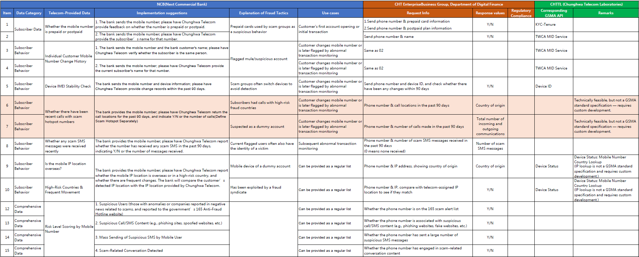
Fraud Prevention Requirements from NCB (translate)

Slide 16
Thanks for your attention!!
Notes:
Taiwan 19
Japan 21
📘 3GPP TS 23.002 – Network Architecture
在描述通話流程時會明確區分：
MO (Mobile Originated) call/message：由使用者主動撥出或發送
MT (Mobile Terminated) call/message：使用者接收來電或簡訊
📘 3GPP TS 29.002 – Mobile Application Part (MAP)
在呼叫控制流程中，常見欄位如：
callingPartyNumber → 主叫號
calledPartyNumber → 被叫號
originatingIMSI、terminatingIMSI → 主叫與被叫的 IMSI

